Slide 1
Abstract
Örnektir
The aim of this study is examine whether cognitive flexibility has a mediator role between job stress and organizational commitment. Independent variable of the study is job stress, dependent variable is organizational commitment and the mediator variable is cognitive flexibility. In this research, quantitative research method and snowball sampling method was applied to collect data.
Data was collected form total of 416 participants, including 83 women and 183 men, working in Istanbul. Participants were asked to fill in their demographic information first, and then they were asked to answer the questions of the Job Stress Scale, the Organizational Commitment Scale, and the Cognitive Flexibility Scale. The collected responses were tested in the SPSS Statistic program by performing demographic analysis, reliability analysis, t-test, correlation, regression analysis and mediation analysis.
According to the findings of the study, the mediating role of cognitive flexibility has been observed. According to the results of the demographic variables, there is no significant difference in organizational commitment levels according to gender and educational status. On the other hand, there is a significant difference in the organizational commitment levels of the variables of marital status, job position, age, income level and total work experience.
Keywords: job stress, organizational commitment, cognitive flexibility

Slide 2
Table of Contents
Örnektir

Slide 3
Introduction
Örnektir
…Human beings are likely to encounter problems in every period of their life. One of the most important of these problems is undoubtedly working life, which covers a large part of human life and provides the necessary financial support to live. Excessive stress, which is the result of modern life, increases its effect not only in private life but also in working life. Factors such as the organizational environment, working styles of the organization, and relationship styles in the organization are increasingly creating sources of stress. For organizations, stress is considered a danger factor and affects the organizational mechanism negatively. It is thought that organizational commitment will provide an advantage in eliminating these negative situations (Eriş, 2018; Aydın & Basım, 2017).
Considering the relationship between stress and organizational commitment, the concept of cognitive flexibility which assumes a mediator role between these two factors, emerges as an important concept in working life. When the literature is examined, it is understood that it is very important to produce solutions with different perspectives to the difficulties encountered throughout life, especially in business life, for flexible mental functions (Cheng, Lau & Chan, 2014; Koçak, 2015; Johnson, 2016).

Slide 4
Literature Review
Örnektir
…Organizational commitment means the employee’s desire to be in the organization, and to obey the working principle and organizational culture in line with the objectives of the organization (Doğan & Kılıç, 2007).
The concept of organizational commitment was first studied by Whyte in 1956, and then elaborated by different researchers. Although there is not a single definition accepted by everyone in the organizational commitment literature, it is possible to encounter widely used definitions (Yeşiltepe, 2020).
Organizational commitment is an individual’s commitment to their workplace (Leong, Furnham & Cooper, 1996). In other words, organizational commitment is a psychological condition that characterizes the employee’s communication with the organization and affects the decision to continue his/her membership in the organization (Meyer & Allen, 1997).

Slide 5
Method
Örnektir
In this research, quantitative research method was used. Research in which experiments, observations and measurements are repeated and objective is called quantitative research. Quantitative research is “explaining phenomena by collecting numerical data that are analysed using mathematically based methods (in particular statistics)” (Muijs, 2014).
…That is, it is not an intense analysis about the subject, on the contrary, it is determined more superficially based on numerical data (Şimşek & Yıldırım, 2005).
…Work experience is another demographic information that is asked to the participants. According to the given answers, participants who have 9 - 15-year work experience and 15 years and above work experience are two heavily represented groups with 36,3% and 32% respectively. Participants who are working at junior level positions are represented by 1 - 3 year working experience with 9,6%. Lastly, participants who have 4 - 8 year working experience consist of 22,1% of participants.

Slide 6
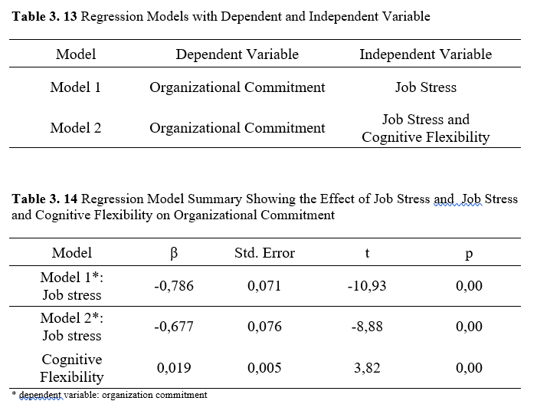
Results
Örnektir
In social sciences, the most emphasis is on internal consistency and reliability. Internal consistency reliability is used to test whether the items in the measurement tool show consistency among themselves (Gürbüz & Şahin, 2016). The method used in determining the internal consistency and the compatibility of the items with each other is the 'Cronbach Alpha' method and it is generally accepted that it takes a value of at least 0.70 and above (Seçer, 2015).

Slide 7
Discussion
Örnektir
In this difference, it was concluded that married people's commitment to the organization is higher than singles. The findings of some studies conducted in the past years show that married people have more organizational commitment than singles, and this situation is explained by the fact that married people have more family responsibilities (Mathieu & Zajac, 1990). Similarly, in the study conducted by Gülova and Demirsoy (2011), it was concluded that organizational commitment significantly differentiated according to marital status. But, unlike this study, Alkoç et al. (2020) concluded that organizational commitment did not differ significantly according to marital status.
There are also studies in the literature stating that there is a positive relationship between organizational commitment and working time. It is thought that long working times increase the personal investments of the employees in the workplace, and this situation affects the emotional commitment of the employees positively (Mathieu & Zajac, 1990; Meyer & Allen, 1997; Cohen & Lowenberg, 1990).

Slide 8
Conclusion
Örnektir
… However, it seems that the results of our study do not support these predictions. In the literature, there are studies that concluded that both gender and education level have an effect on organizational commitment or not (Shore et al., 1995; Cheng & Stockdale, 2003; Simmons, 2005; Uygur, 2009; Kuusio et al., 2010). It is considered that the differences between the study results may be due to the context of the studies.
…Income is one of the most important organizational factors in the motivation of the employees. Employees' income that they earn as a result of their efforts cause an increase in their organizational commitment (Türkoğlu, 2011).

Slide 9
References
Örnektir
Akinyomi, O. J. (2016). Labour turnover: Causes, consequences and prevention. Fountain University Journal of Management and Social Sciences, 5(1) Special Edition, 105-112.
Aktaş, A. & Aktaş, R. (1992). İş stresi. Verimlilik Dergisi, 1, 153-171.
Aktepe, R. (2019). Lise öğrencilerinin bilişsel esnekliklerinin cinsiyetlerine ve mizah tarzlarına göre incelenmesi. Kastamonu Eğitim Dergisi, 27(6), 2631-2640.
Akyürek, E. Ç., Toygar, A. Ş., Eriş, H. & Top, M. (2011). Buzdağının görünmeyen kısmı: İş kazaları ve meslek hastalıklarının yönetsel yansımaları. Hacettepe Sağlık İdaresi Dergisi, 14 (2), 125-149.
Alkoç, E., Uysal, G. & Alkoç, B. (2020). Sigorta sektöründe personel güçlendirmenin örgütsel bağlılığa etkisi: Samsun ili örneği. Avrasya Sosyal ve Ekonomi Araştırmaları Dergisi, 7 (3), 19-38.
Allen, N. J. & Meyer, J. P. (1993). Organizational commitment: evidence of career stage effects?. Journal of Business Research, 26 (1), 49-61.
Altunkol, F. (2011). Üniversite öğrencilerinin bilişsel esneklikleri ile algılanan stres düzeyleri arasındaki ilişkinin incelenmesi. (Yayımlanmamış yüksek lisans tezi). Çukurova Üniversitesi Sosyal Bilimler Enstitüsü, Adana
Altuntaş, E. (2003). Stres yönetimi. İstanbul: Alfa Yayınları.
Angle, H. L. & Perry, J. L. (1983). Organizational commitment: Individual and organizational influences. Work and occupations, 10 (2), 123-146.
Apuke, O. D. (2017). Quantitative research methods: A synopsis approach. Arabian Journal of Business and Management Review (Kuwait Chapter), 6 (10), 40-47.
Arslan, R. & Demirci, K. (2015). Örgütlerde öğrenen örgüt kültürüne ilişkin algıların örgütsel bağlılık üzerine etkisi ve kamu kurumunda bir uygulama. Dumlupınar Üniversitesi Sosyal Bilimler Dergisi, 43, 24-38.
Artan, İ. (1986). Örgütsel stres kaynakları ve yöneticiler üzerinde bir uygulama. İstanbul: Banka-Sigorta İşçileri Sendikası Eğitim ve Kültür Yayınları.

